Slide 1
Towards 6G Wireless Networks in Edge Computing
Awais Bin Asif
Supervised By: George Pallis, Marios Dikaiakos
University of Cyprus, Cyprus

Slide 2
Motivation
Applications like Real Time Analytics requires high data rate between IOT devices/Sensors and Edge Computing nodes.
6G network is the future network to fulfill the requirments of high data rate.
6G network is supposed to use unutilized frequency bands such as TerraHertz.
High frequency band requires LOS communication between transmitter and receiver which is not possible in dense urban areas.
Intelligent Relecting Surface resolves the issue of LOS communication.
Captivating advantages of IRS within 6G networks motivates us to extend the 5G Slicer.
The extension of 5G Slicer allows us to deploy, test and evaluate 6G network in virtual environment.

Slide 3
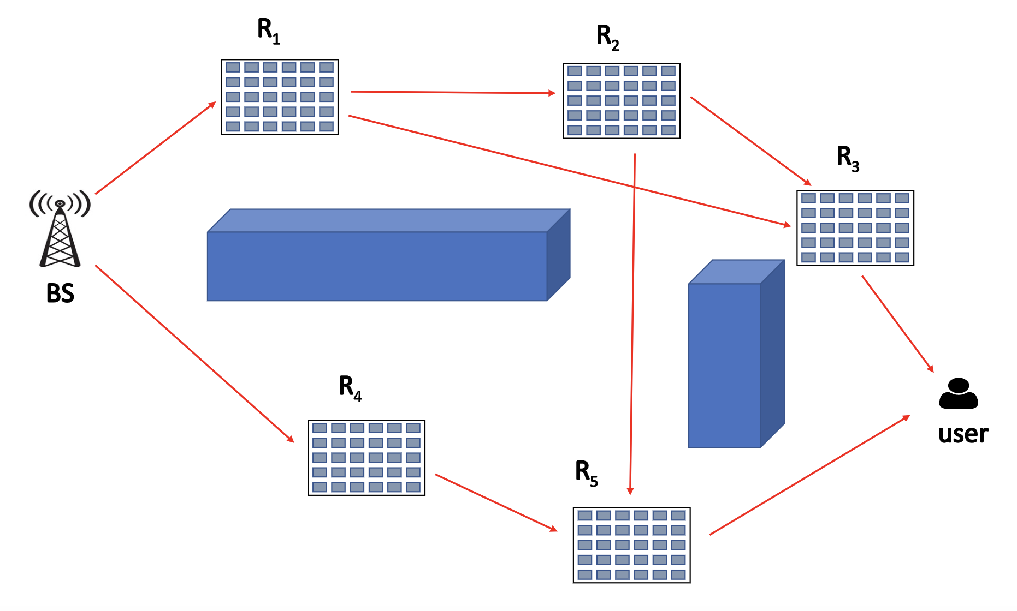
Example of IRS-aided 6G wireless network

Slide 4
Architecture
User requirements
Analysis based on QoS Function (Latency, Data Rate,
Received Power)
Client Side
5G Slicer SDK
IRS lib
Control
Layer
Fogify Controller
API
Parser
Orchestrator Connector
Cluster Orchestrator
Edge node
Edge node
Edge node
Overlay network
Services
Services
Services

Slide 5
Workflow of IRS lib
Input
(User requirements/
Services required)
Create Network Topology using SAP theorem
Deploy the 6G Network
Allocate resources to the user
Evaluate network performance
Execute QoS
(Latency, Data Rate, Received Power) functions
Request Edge Nodes for Services

Slide 6
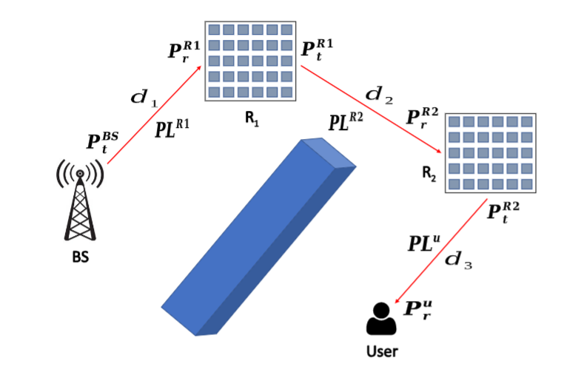
Channel Model

Slide 7
Thank You

